Slide 1
SEL Blueframe Python SDK
Caleb Hansen, Genevieve Kochel, Darron Li, Lucas Phillips
CptS 421

Slide 2
Introduction

Slide 3
INTRODUCTION
Blueframe is a hardened OS suited for real-time monitoring at edge locations
Based on stripped-down Linux kernel
Not designed for ease of use: our project aims to address this
To do this, we’ll abstract away low-level Blueframe system API calls via a Python library
Our first sprint has been focused on understanding where our project fits in to the ecosystem, and what our deliverables are

Slide 4
SPRINT 1 GOALS
Gain an understanding of the Blueframe platform
This involved meetings with automation engineers, senior Blueframe engineers, and system designers
Narrow down the scope of our project to something attainable within the context of a capstone project
We evaluated the most valuable functionality by examining current workflow of users, and what would provide the most benefit
Determine state of previous work on this project, and get set up with repository
Become familiar with codebase in order to begin architecting solutions

Slide 5
REQUIREMENTS GATHERING
We had several meetings. These included:
Initial setup meeting and walkthrough of Blueframe platform
Discussion of Blueframe documentation and SDK workflow
Blueframe OS setup requirements for local development
SignalHub info discussion
Intro to SignalHub Go repository
Through these meetings, we narrowed down our focus to specifically the SignalHub platform, which essentially acts as a message bus for all Blueframe services. It works by sending binary blobs over raw TCP, so a high-level abstraction layer will be extremely useful for engineers not familiar with the in-depth API specifics.

Slide 6
MEETING MINUTES
Signal Hub Meeting #1
https://docs.google.com/document/d/1jn55gCFu4wpZitNWfPhAz6XTImmWWTWcXC_IuDJw874/edit?usp=sharing
Signal Hub Meeting #2
https://docs.google.com/document/d/1vNIO9jNA18AkktPuvSEnWVt20zawMksBdGD_Iv-KC0U/edit?usp=sharing

Slide 7
Documentation

Slide 8
USER STORIES
As an engineer, I want to subscribe to a device signal using a high-level method, so that I can receive real-time data.
As an engineer, I want to publish device data to a SignalHub channel using a high-level method, so that other systems can consume the data.
As an engineer, I want to authenticate and establish a secure session with SignalHub, so that I can interact with device signals.

Slide 9
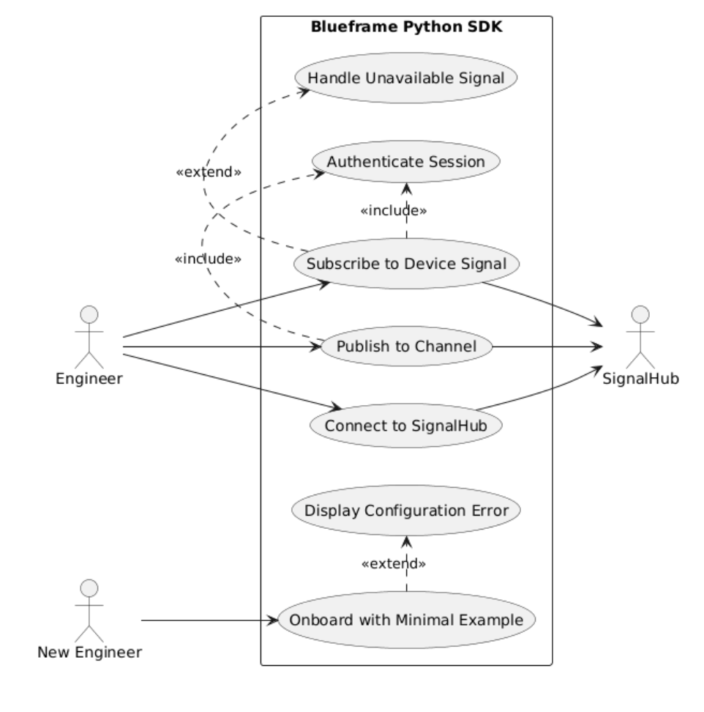
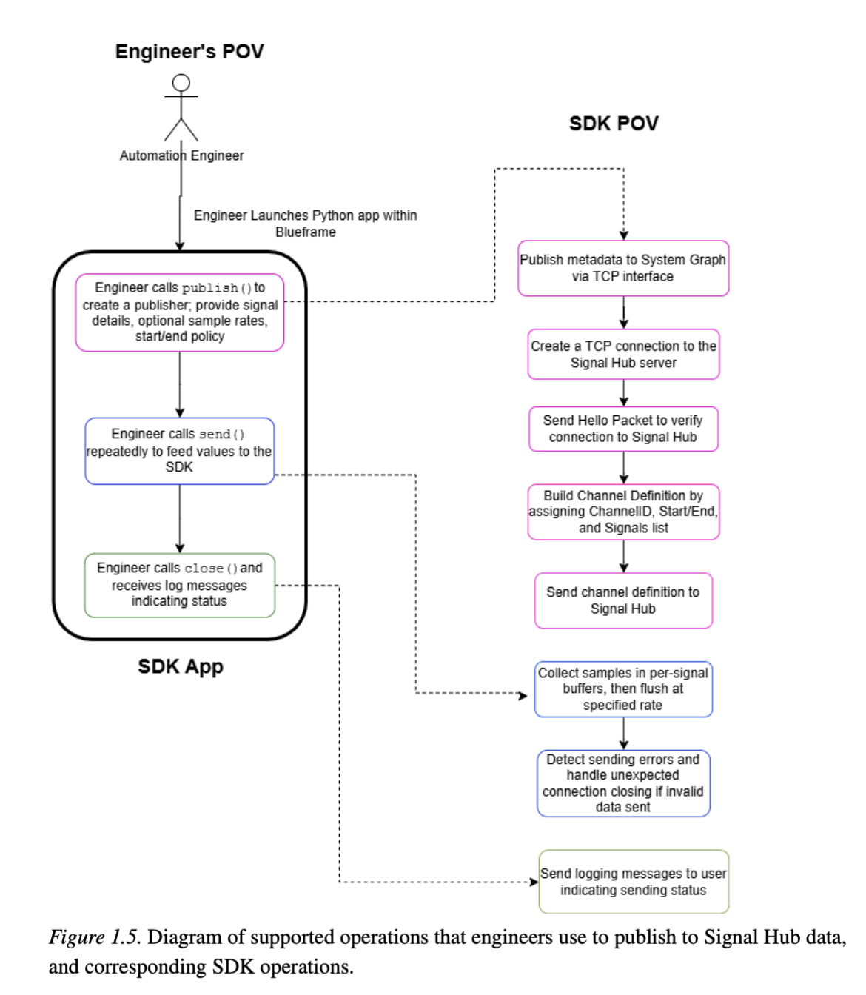
USE CASE DIAGRAMS

Slide 10
Setup of Existing Solution

Slide 11
SETUP OF EXISTING SOLUTION
Blueframe is a proprietary operating system, and each image is specially signed by SEL for use with approved devices only. We cannot run Blueframe directly.
There is a Docker solution for container-based development, which we have set up. However, this code is strictly proprietary, and cannot be shared outside of SEL. We are unable to show any of it.
Currently, a Go repository handles SignalHub very well, and is still under active development. Our Python library will likely need to interface with that repository; this is still being explored.

Slide 12
Team Contributions

Slide 13
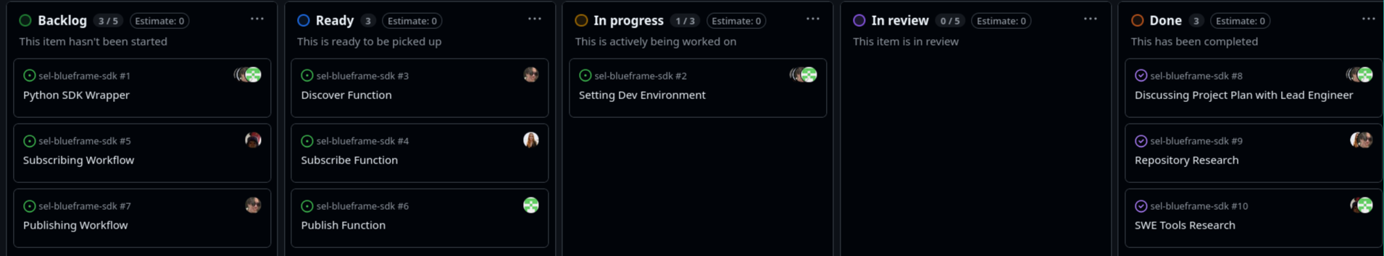
TEAM CONTRIBUTIONS: KANBAN BOARD

Slide 14
TEAM CONTRIBUTIONS: COMPLETED WORK
Because we are still in the requirements gathering stage, there are no completed features. However, we have made tremendous progress on documentation: in particular, a SignalHub spec document

Slide 15
TEAM CONTRIBUTIONS: SKILLS LEARNED
Darron:
Learned about Helm, Tilt, Kubernetes, and K3s for production level software
Learned about how each containers interacted with each othr
Lucas:
Learned about Helm, Kubernetes, and Blueframe-specific topics like SignalHub and IEDs
Gained insights into the practical applications of Electrical Engineering and the specific software needs of automation engineers to optimize their workflows.
Caleb:
Learned about Blueframe and SignalHub; gained experience narrowing down scope of a project and learning a system quickly
Learned about automation engineer workflows, and what matters to them (experience tailoring a project to particular use cases)
Genevieve:
Learned to quickly source documents and ask good questions/review documents quickly
Learned about Docker, Tilt, and many SEL-specific concepts like power grids and how engineers interact with Blueframe to gather data about the power grid

Slide 16
SPRINT ACHIEVEMENTS AND CHALLENGES
Achievements:
Learned extensively about how Blueframe operates, core OS concepts, Signal Hub technical details and how to gather these details from complex documents
Created detailed documentation on the inner technical details of Signal Hub, and proposed our project specification to our supervisor for review
Asking good questions to narrow down our project scope
Challenges:
Finding the correct people to talk to, to answer our questions - Reached out to many people at SEL daily, which guided us towards the right people eventually
Since our project was dropped by our original clients, we struggled to find another project. We leveraged our current connections at our internships to successfully find a sponsor.

Slide 17
RESPONSIBLE USE OF AI
We used AI for summarizing/understanding meetings, drafting some documents, and identifying potential use cases to propose to our stakeholders
Limitations:
Since our project contains SEL specific information, AI is often not able to answer questions about the specific technologies and implementations. Thus , we sought out other documentation to answer more specific technical questions.
We used the SEL specific GitHub Copiolot to process SEL-confidential information to ensure security of SEL information. This is necessary because typical non-company AI tools do not fit within security regulations for SEL.

Slide 18
Sprint Retrospective

Slide 19
NEXT STEPS AND SPRINT RETROSPECTIVE
Next steps:
Get Blueframe environment set up outside of SEL for code development
Look into the Go repository to see what functionalities need to be implemented from scratch/what is already implemented
What went well:
We were able to connect with many engineers to gather information in a timely manner
We communicated clearly with each other and kept everyone in the loop of the project progress
Improvements:
Get access to more documents and code for non-SEL intern group members for more balanced sharing of information

Slide 20
CONCLUSION
Overall, the first sprint has been a success, and we’ve enjoyed learning about Blueframe and SignalHub. We’re very grateful for this opportunity, and excited to continue development on this project!

Slide 21
THANK YOU

